Slide 1
ENSE 374, Milestone 2
22/10/2019
Daniel Takyi
Jiwoun Kim
Mason Lane

Slide 2
Team: They Will
We’re creating a web-app that provides random venues for a user to explore.
People should be able to garner a random list of curated results after entering various search parameters.
Sometimes decisions are hard - sometimes we worry. What if we miss out on something? Everyone lives with regrets. Many people find themselves wondering what curiosities they’ve overlooked or missed. This application will grant users the opportunity to discover and enjoy new experiences by suggesting random food locations. It will help the indecisive make quick novel decisions, or simply grant the experimental types new adventures to behold.
https://github.com/jiwoone/ENSE-374-Project.git

Slide 3
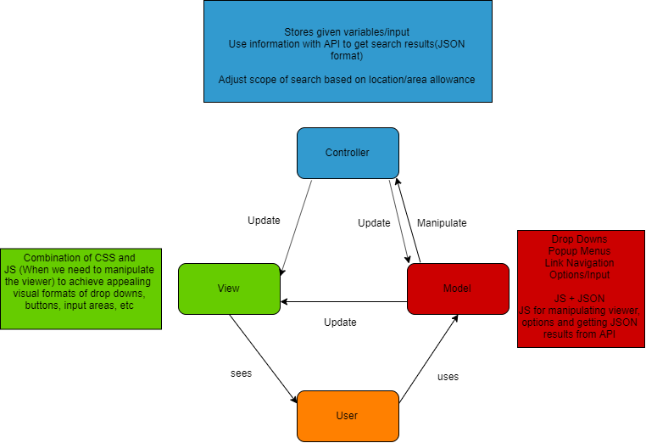
MVC

Slide 4
Communication/Collaboration
User
1. *: Search()
1.2[random]:listView()
Places List
Map
1.3[LooksGood]: ViewDetail()
Place Detail

Slide 5
Data Flow
Searching
User
Search with current location
Search Results (List)
Find Places
A place
Map API

Slide 6
Class Diagram
PlaceDetail
PlacesList
-Description: string
-operationTime: Date() -phoneNumber: int
-priceRange: int
-menues: string
-recentReviewArticle: string
-overallRatings: int
-restaurants: string -categories: string
-url: string
-overallRatings: int
-miniMapUrl: string
-priceRange: int
SearchLocation
-longitude: double
-latitude: double -type: string
-searchText: string
<<get search results>>
<<get details>>
1:*
1:*
<<get menues information>>
1:*
/* We can get the longitude and latitude by using a javascript function. However, the browser might not support it. Then we use searchText option for user could type the city or the location manually. */
/* if the place has own website, url will be the website address. Url possibly does not exist. */
TopMenues
-menues: string
-price: double
-ratings: int
/* There are possibly no information on menues of the place */

Slide 7
Sequence Diagram
User
Map
Loop
Place Search
Search Results
View Lists
View Details

Slide 8
Use Case
Search Places Nearby
<<requires>>
<<requires>>
<<extends>>
Provide Places (Maps)
View a List of Places
<<extends>>
User
<<requires>>
Google Places API
View details of a Place

Slide 9
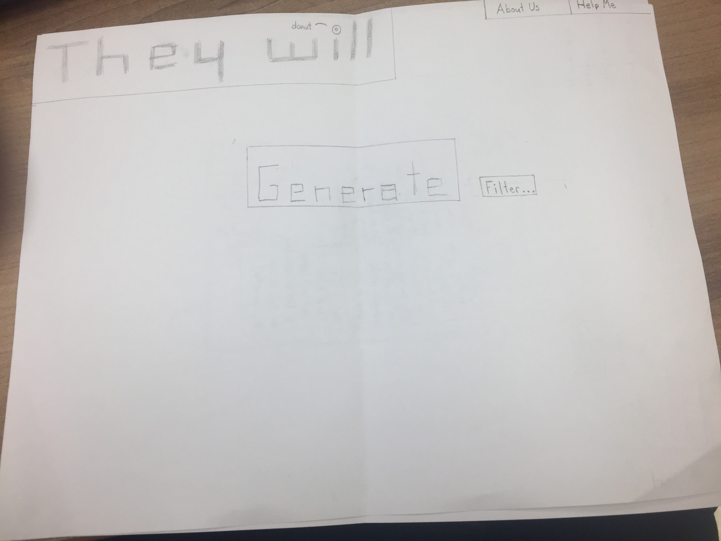
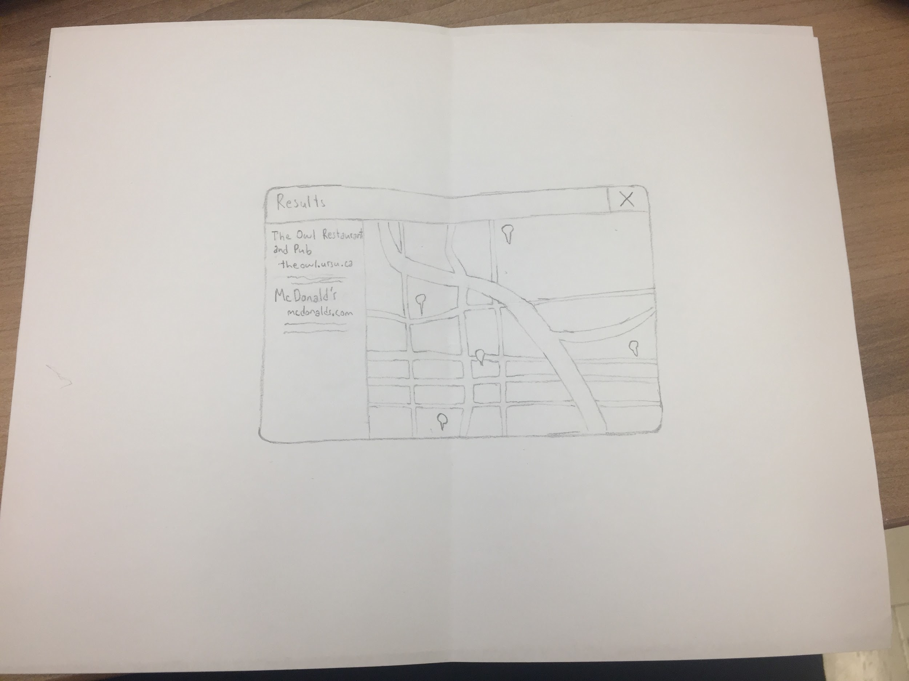
LoFI Prototype
Main Page
Results Page

Slide 10
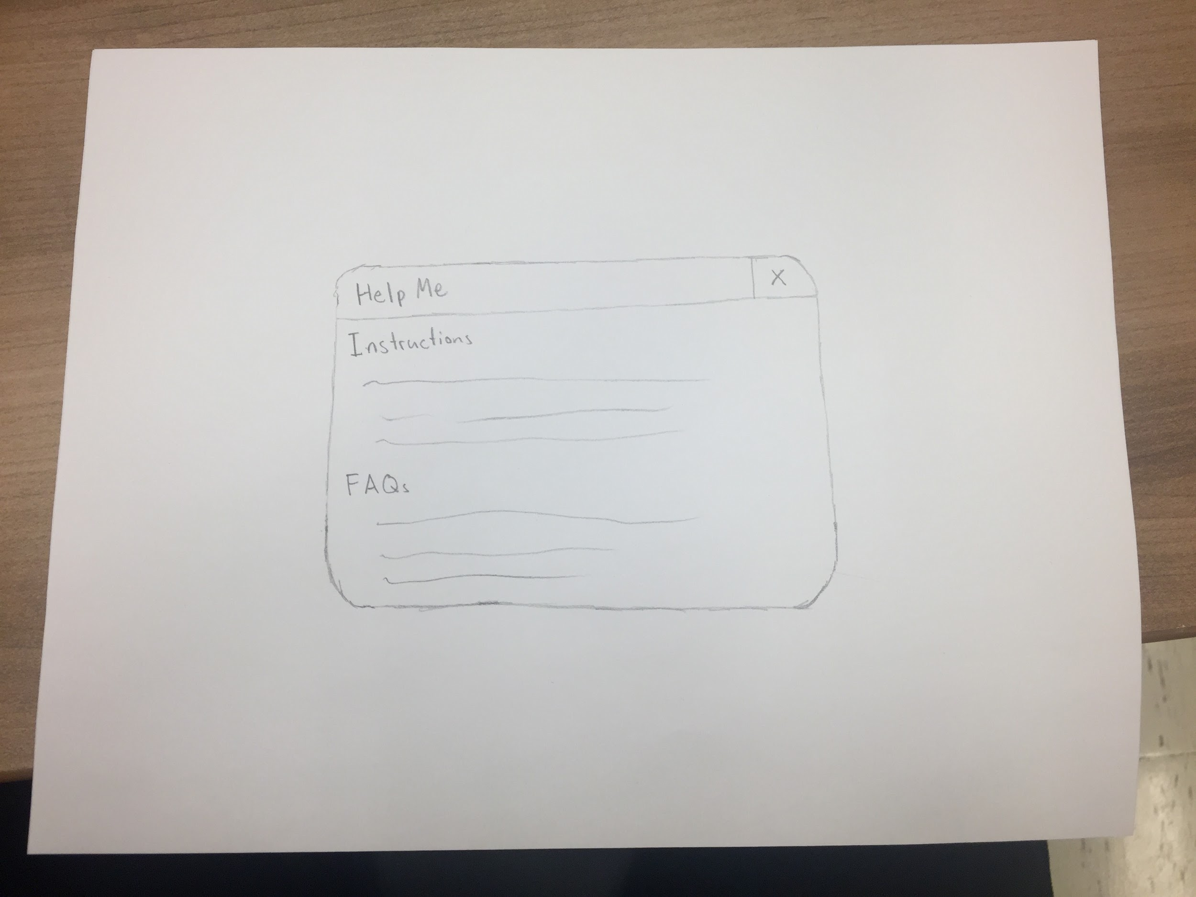
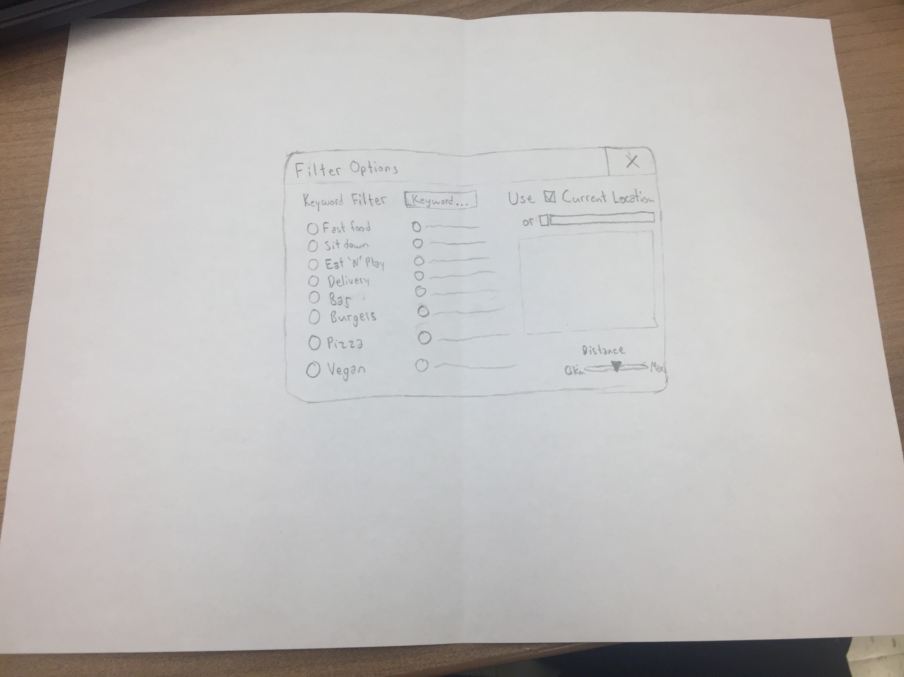
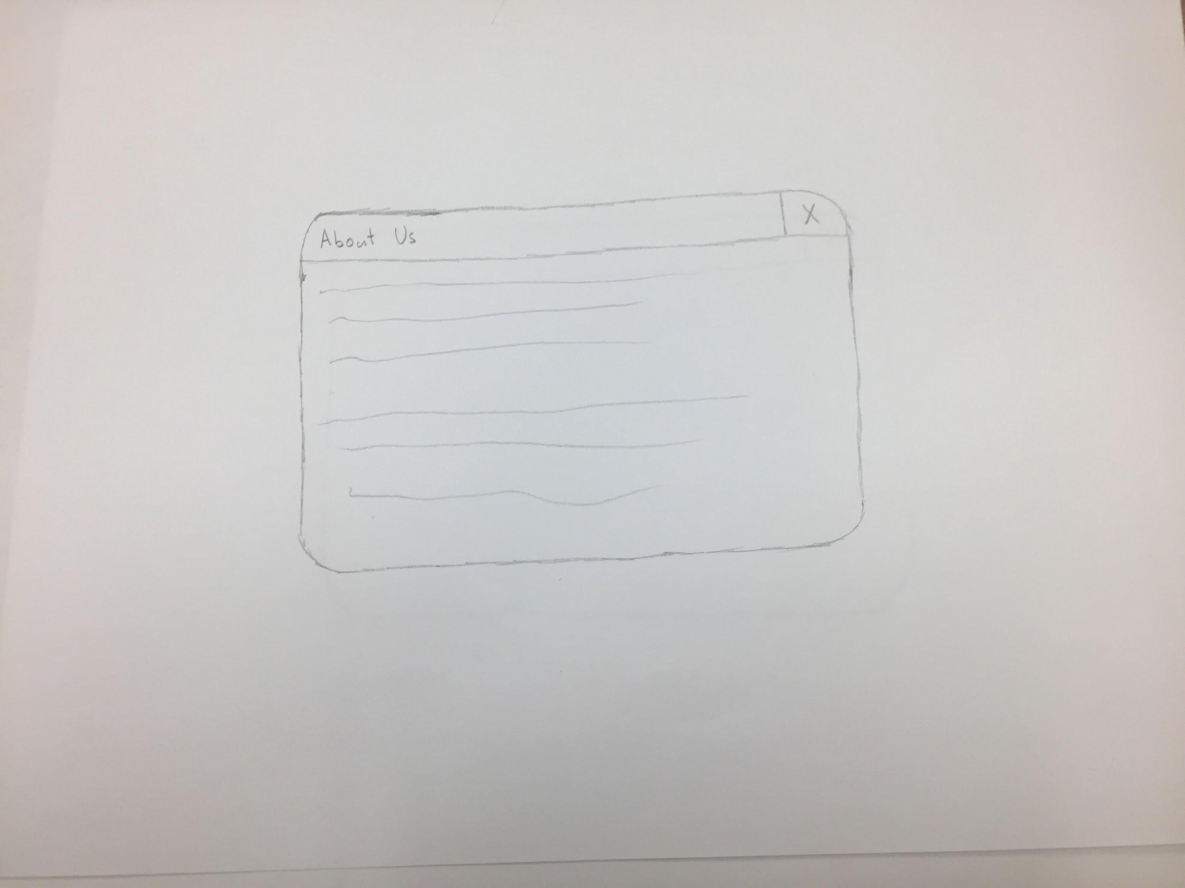
Help Me Page
Filter Page
About Us Page

Slide 11
Requirements (We made one!)
In short, a user should be able to choose between two options
One that begins a search using predefined parameters
A second that allows for custom settings
Choosing the latter must allow users to curate their own search.
They will choose from a variety of parameters
Regardless of the above options, we will use these parameters with the Google Places API to garner results.
These results will then be displayed
Selecting a result must provide venue details (menu, website, etc)
It has to be handy - something someone can use in only a few moments
Therefore as browser based app, it must be mobile friendly.
Following the pursuit of an MVP, we’ve tried to be aware of our scope, making considerations for whether or not we can accomodate the Google Places API...

Slide 12
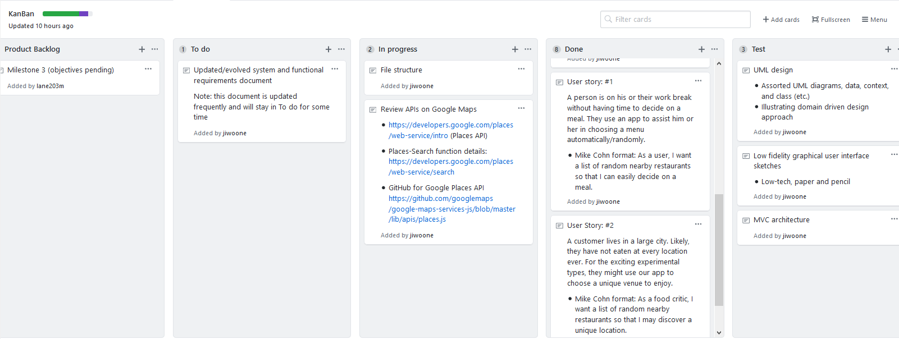
Kanban
https://github.com/jiwoone/ENSE-374-Project.git
https://github.com/jiwoone/ENSE-374-Project/projects/1

Slide 13
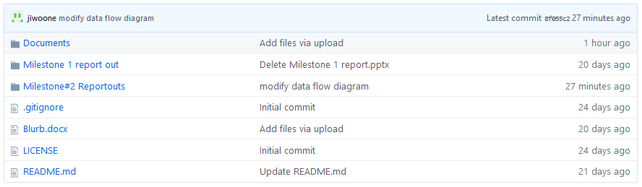
GitHub
https://github.com/jiwoone/ENSE-374-Project.git

Slide 14
Group reflection
•How did you feel about this milestone? What did you like about it? What did you dislike?
•We collaborated more as a team. This milestone felt like it had more substance, with a greater amount of work and design put in.
•What did you learn about yourself as you collaborated and worked through this milestone?
•Software architecture appears daunting at first, but gets easier as you study and things fall into place.
•How will you use what you have learned going forward?
•As we’ve begun investigating the Google Places API, we also discovered other interesting APIs that could be fun to explore.
•What “stuff & things” related to this milestone would you want help with?
•We are concerned with the accessibility of the Google Places API and its unforseen $32/1000 clicks fee.

